Slide 1
EduVision_DV
Higher Education Performance Analytics
Data Engineering • KPI Analytics • Tableau Visualization
Project Presentation
Name: Vepanjeri Hasini
Academic Year: 2026

Slide 2
Project Overview
What EduVision_DV does
Integrated Higher-Education Data
Combines university ranking, research, student and country-level education data.
Analytical Data Model
Transforms cleaned source data into dimensions, fact tables and engineered KPIs.
Interactive Dashboards
Presents insights through four integrated Tableau dashboards.
End-to-end workflow from raw data to final delivery
Focus on institutional performance and academic excellence
Designed for comparison, exploration and decision support
2

Slide 3
Problem Statement
Why an integrated analytics system is needed
Fragmented Data
Ranking and education information comes from different sources, structures and naming conventions.
Difficult Comparison
Without standardization and a common model, university and country comparisons are difficult.
Limited Visibility
Raw datasets do not provide a unified interactive view of performance indicators.
Higher education data is available from multiple sources such as QS and Times Higher Education, but it is often complex, fragmented, and difficult to interpret. There is a need for an interactive analytics solution that can transform this raw data into meaningful insights for evaluating university performance, research strength, student diversity, and country-level education trends.
Goal: Convert fragmented higher-education data into a validated, interactive analytical system.
3

Slide 4
Project Objectives
Collect and prepare higher-education datasets from multiple sources.
Clean, standardize and match university and country information.
Build a structured analytical data model.
Engineer and validate key performance indicators.
Develop and integrate interactive Tableau dashboards.
Test data accuracy, calculations and dashboard interactions.
Deliver the final workbook, documentation and QA artifacts.
4

Slide 5
Data Sources
Public datasets used in the project
QS World University Rankings 2025
University ranking and performance indicators
Times Higher Education 2024
University performance and ranking indicators
World University Rankings 2023
Historical university ranking information
World Bank Education Statistics
Country-level education indicators
5

Slide 6
Data Processing & Methodology
1. Data Collection
2. Cleaning
3. Standardization
4. University & Country Matching
Collected ranking and education data from multiple public sources.
Handled missing values, duplicates, and inconsistent data formats
Standardized university names, country names, fields, and data formats
Matched universities and countries across different datasets.
5. Data Modeling
6. KPI Engineering
7. Validation
8. Tableau Development
Created dimension and fact tables using a structured star schema.
Developed six KPIs to measure university and research performance.
Verified data integrity, KPI calculations, rankings, and relationships
Built and integrated four interactive Tableau dashboards.
6

Slide 7
Analytical Data Model
Star-schema structure
FACT_UNIVERSITY_PERFORMANCE
Analytical fact table
FACT_RESEARCH
Analytical fact table
DIM_UNIVERSITY
University-level master dimension
DIM_COUNTRY
Country-level master dimension
FACT_STUDENT
Analytical fact table
FACT_COUNTRY_EDUCATION
Analytical fact table
7

Slide 8
Key Performance Indicators
Six core engineered KPIs
Global Ranking Score
Measures overall global ranking performance.
Research Impact Score
Measures research impact and citation performance.
Faculty-to-Student Ratio
Measures students relative to faculty or staff.
International Student Percentage
Shows the proportion of international students.
Academic Reputation Score
Measures the university's academic reputation.
Research Productivity Index
Measures productivity using research-related indicators.
8

Slide 9
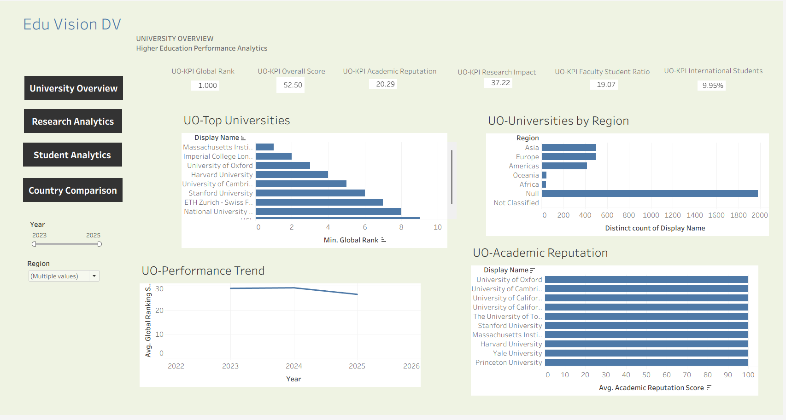
Dashboard Highlights
University Overview
RESEARCH ANALYTICS SCREENSHOT
10

Slide 10
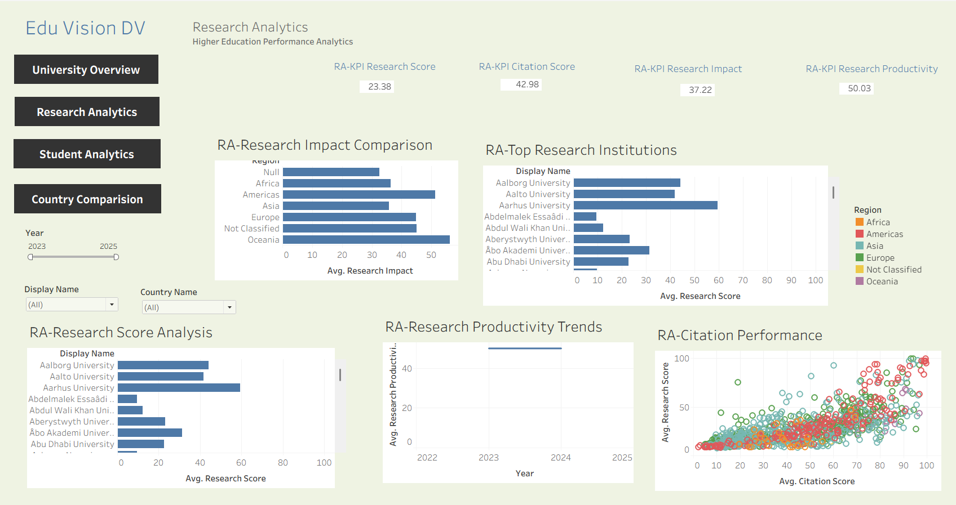
Dashboard Highlights
Research Analytics
RESEARCH ANALYTICS SCREENSHOT
10

Slide 11
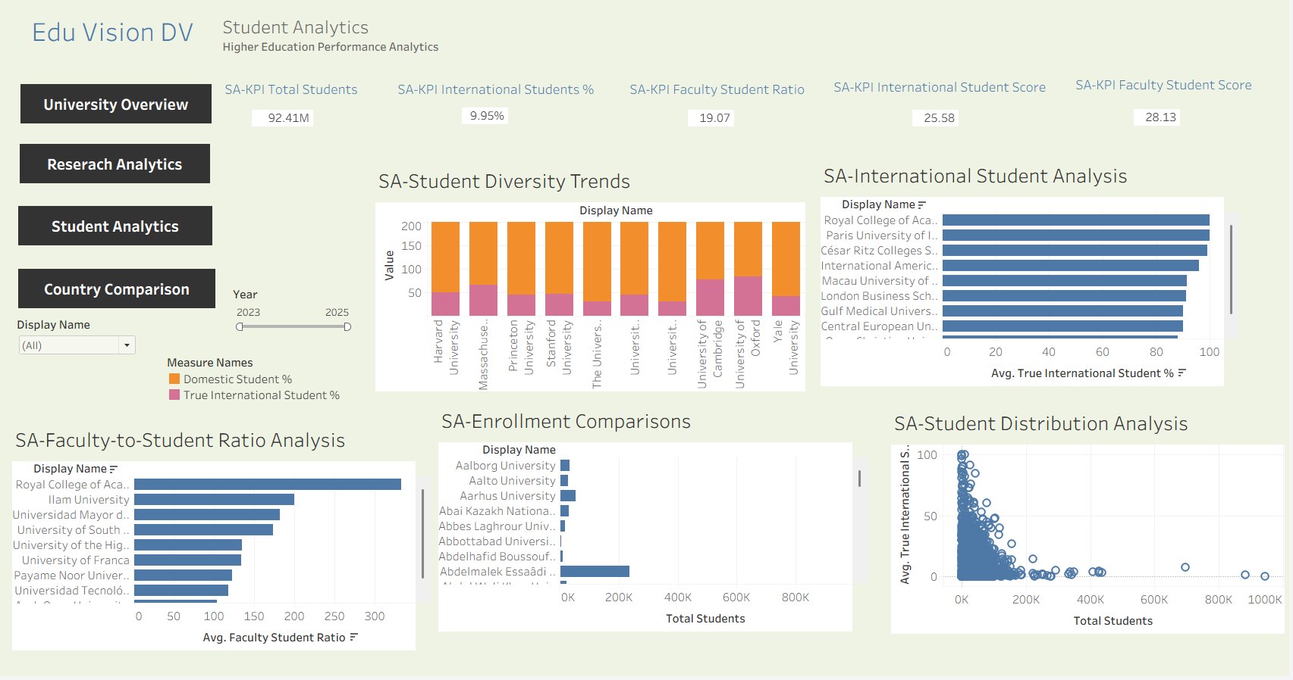
Dashboard Highlights
Student Analytics
10

Slide 12
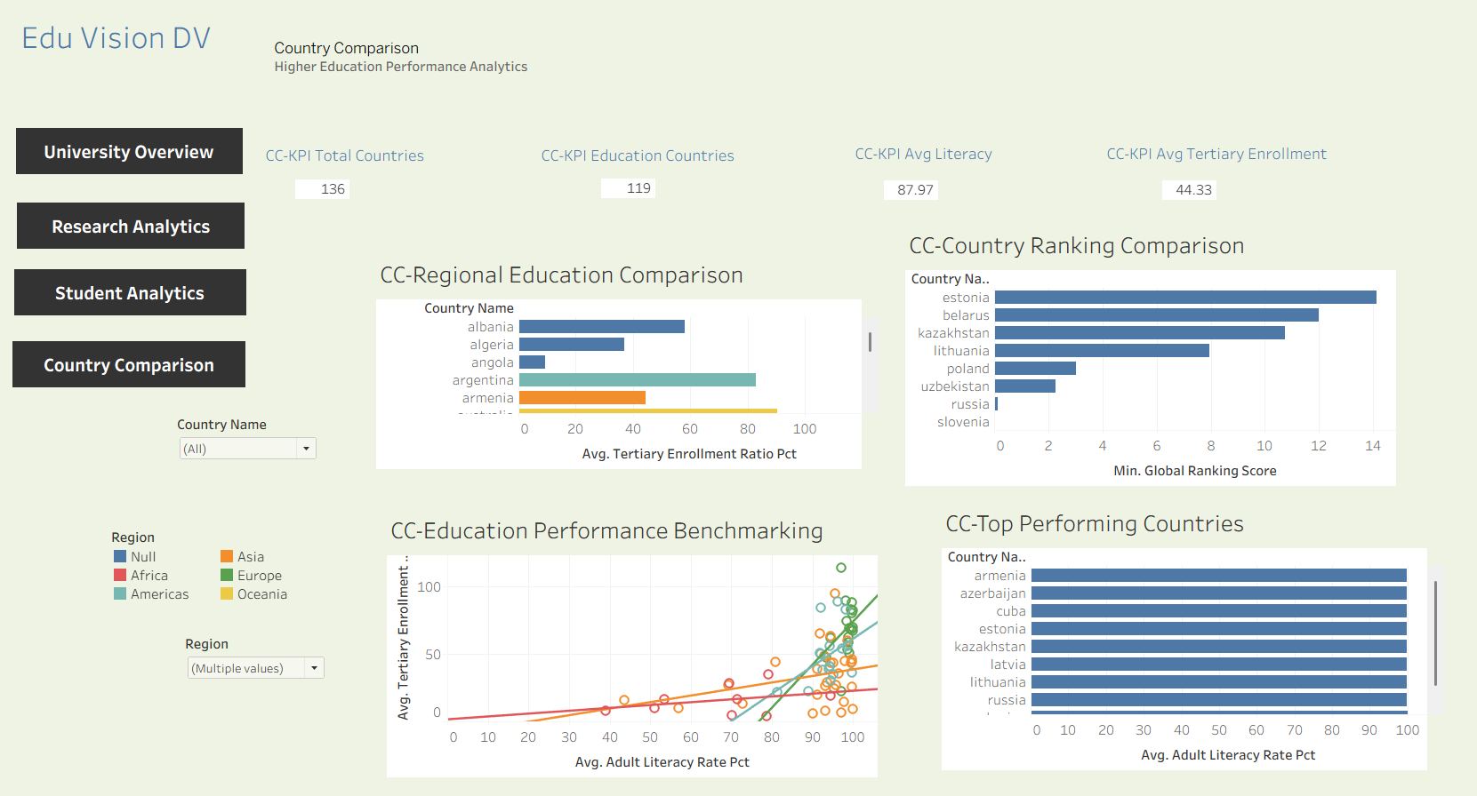
Dashboard Highlights
Country Comparison
10

Slide 13
Testing & Quality Assurance
Validation performed before final delivery
30
QA test cases
26
PASS
2
PASS WITH NOTE
2
MANUAL
University and country ID uniqueness validated
Fact-table composite keys and referential integrity checked
KPI calculations independently validated
Ranking and educational metrics validated
Dashboard rendering, navigation, filters and interactions tested
Final Tableau workbook and documentation prepared
12

Slide 14
Final Results & Deliverables
4,708
Unique universities
136
Countries
119
Countries with World Bank indicators
6,409
University/source/year records
Four integrated Tableau dashboards
Validated analytical data model and KPIs
Final Tableau workbook and dashboard PDF
QA checklist, testing report and final documentation
Complete GitHub project repository
13

Slide 15
Conclusion
EduVision_DV
A complete higher-education analytics workflow from raw data to validated interactive dashboards.
Integrated multi-source higher-education data
Structured analytical model and engineered KPIs
Interactive Tableau dashboard system
Testing, QA and complete project documentation
14

Slide 16
Thank you
15

